Slide 1
UW MS Capstone Project
HUD HEARS Study
Hantong Hu, Taylor Keating, Zichen Liu, Niki Petrakos | UW Biostatistics
Danny Colombara, Alastair Matheson | Public Health - Seattle King County

Slide 2
Meet the Team
Hantong Hu
Taylor Keating
Zichen Liu
Niki Petrakos
Danny Colombara,
PhD
Alastair Matheson,
PhD
Patrick Heagerty,
PhD
Lloyd Mancl,
PhD

Slide 3
Background
Housing is a social determinant of health
Lack of affordable housing is a public health issue but affordable housing is a limited resource
US Department of HUD wants to help people exit from affordable housing with long-term benefits
Problem: existing literature is sparse in
Defining +/- exits
Exploring factors associated with +/- exits
Examining long-term outcomes from different +/- exits

Slide 4
Primary Objective
To determine if there is an association between positive/negative exit types and long-term outcomes
Positive exit (vs. neutral)
Housing outcome
Time to experiencing homelessness within 1 year of exit
Negative exit (vs. neutral)

Slide 5
Study Population
Seattle Housing Authority
(2012 to 2019)
King County Housing Authority
(2016 to 2019)
Renton Housing Authority
EXCLUDED
Populations receiving federal housing assistance
Public housing (hard-unit)
Receiving a Housing Choice Voucher (soft-unit)
Other housing assistance
EXCLUDED

Slide 6
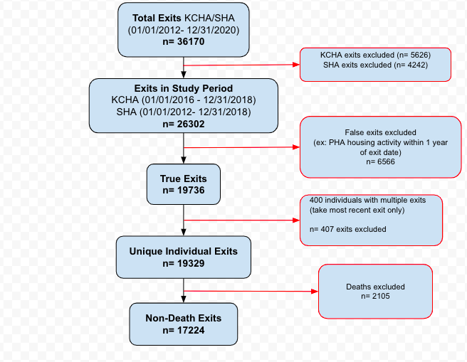
Flowchart

Slide 7
Data Sources
Public Housing
(HUD Form 50058 MTW)
Housing status, individual characteristics, household characteristics
Date of experiencing housing insecurity
Medicaid (Apple Health)
Behavioral Health Recovery Division
Homeless Management Information System
Health Care for Homeless Network
Puget Sound
Regional Council
Opportunity Mapping
Neighborhood quality/opportunity
Merged via census tract
Merged via SSN, name, DOB, gender

Slide 8
Variables
Individual
Household
Neighborhood
Age at exit
Gender
Race/ethnicity
Time to homelessness
SHA or KCHA
Program type
Single caregiver
Household size
HoH has disability
Duration before exit
Exit type
Opportunity area index
Clustering by
Household ID

Slide 9
Time to Homelessness Outcome
Start date later than exit date
Homelessness within 30 days prior to exit date is counted
Status ≠ “homeless” → 365 days
> 365 days → censored at 365 days
Get the earliest occurrence of homelessness, or censoring, per ID
Days to first instance of homelessness within the first year of exiting public housing

Slide 10
Descriptive Statistics

Slide 11
Descriptive Statistics Summary
Sample size: 17,224 (1 exit per person)
Events: 2,794 (16%) experienced homelessness within 1 year of exit
Missingness
Opportunity score: 3% missing
Other covariates: less than 2%

Slide 12
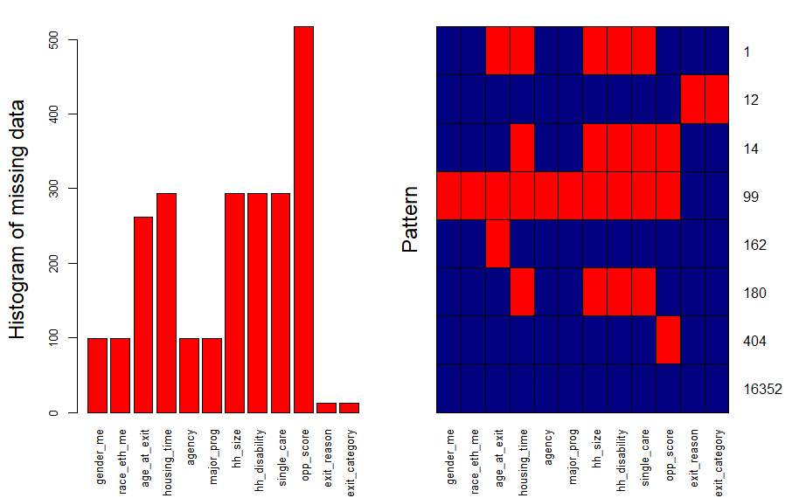
Missingness Pattern
Missing
Not missing

Slide 13
Kaplan-Meier Curves
Distinct survival curves
Largest drop from 0 - 50 days
Probability remaining housed at 1-year after exit:
Positive: 97%
Neutral: 85%
Negative: 75%

Slide 14
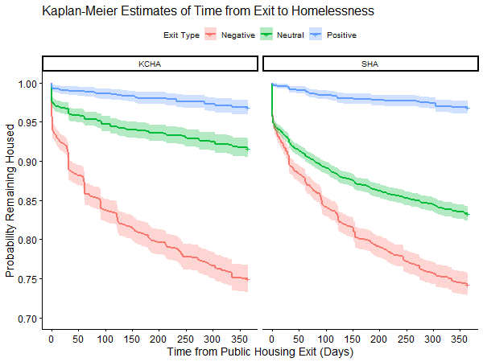
Kaplan-Meier Curves (Separated by PHA)
KM-estimates (probability remaining housed) at 1-year after exit:
Exit Type | KCHA | SHA
Negative | 75.0 | 74.3
Neutral | 91.7 | 83.3
Positive | 96.9 | 96.9

Slide 15
Regression Methods
Step 1
Step 2
Step 3
Derive propensity scores
Multinomial logistic regression with GEE
(clustering by household)
log P(exit_type|covs)
exit_type = POS, NEG, NEU
Calculate weight
for each observation
Inverse probability treatment weighting
One of:
1/PS_{NEG} 1/PS_{NEU} 1/PS_{POS}
Housing outcome
Weighted Cox PH model
h_{homeless}(t) ~ h₀(t)e^{POS + NEG}
Clustering by household
(robust sandwich estimator)

Slide 16
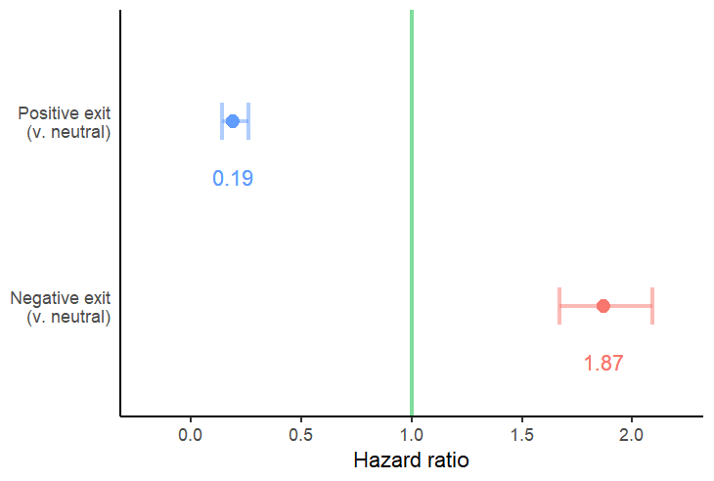
Regression Results
Positive exits 81% less likely to experience homelessness than neutral exits
Negative exits 87% more likely to experience homelessness than neutral exits

Slide 17
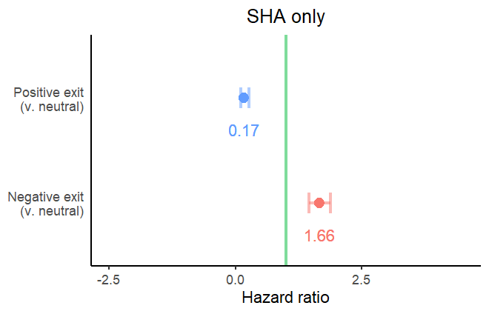
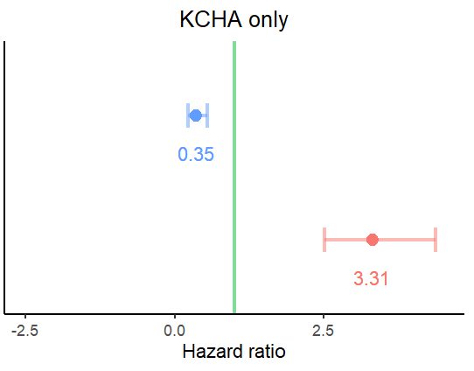
Regression Results (Separated by PHA)

Slide 18
Sensitivity Analysis
Do the results of the primary analyses differ after exit reasons are removed one at a time?
exit reason 1
exit reason 2
exit reason 1
exit reason 1
exit reason 2
exit reason 1
exit reason 2
exit reason 2
exit reason 3
exit reason 4
exit reason 3
exit reason 4
exit reason 3
exit reason 3
exit reason 4
exit reason 4
exit reason 5
exit reason 6
exit reason 5
exit reason 6
exit reason 5
exit reason 6
exit reason 5
exit reason 6

Slide 19
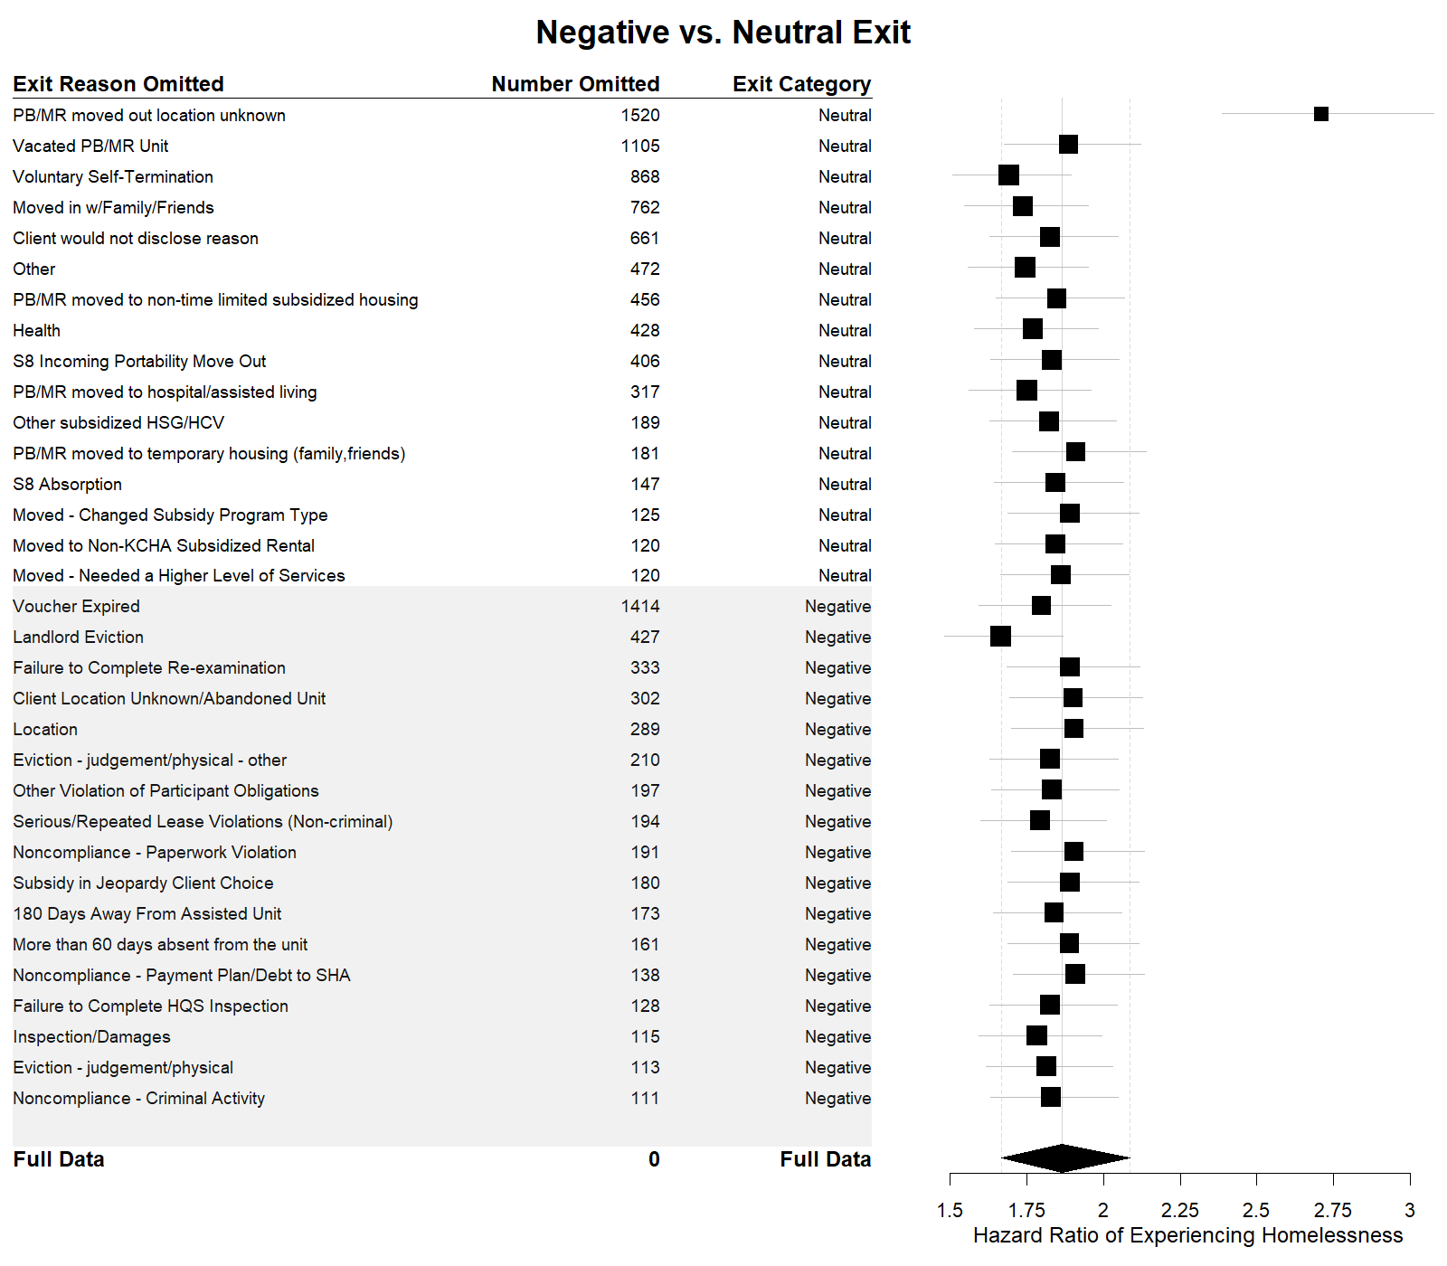
Interpretation:
A lower HR estimate (closer to 1) leads to negative and neutral exits being more similar
A higher HR estimate (further from 1) leads to negative and neutral exits being less similar
Findings:
Overall, results support conclusions from primary analysis
Landlord evictions appear to have greatest impact on homelessness among negative exit reasons
PB/MR moved out location unknown potentially more similar to negative exit reasons than neutral

Slide 20
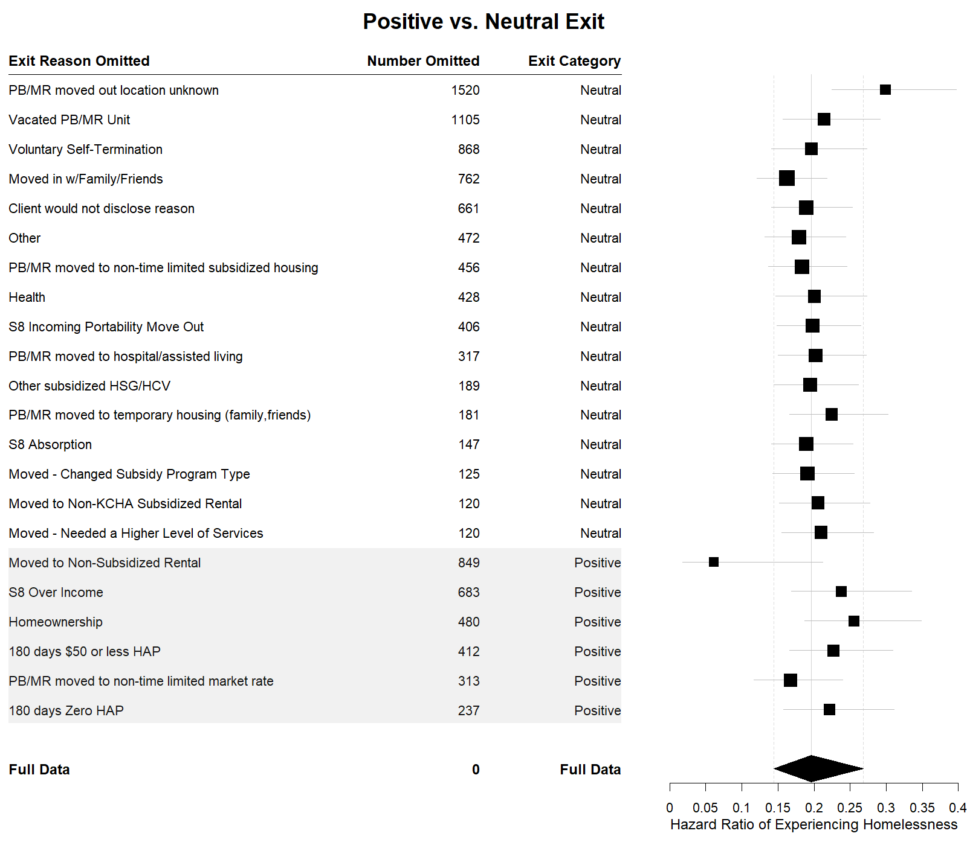
Interpretation:
A lower HR estimate (further from 1) leads to positive and neutral exits being less similar
A higher HR estimate (closer to 1) leads to positive and neutral exits being more similar
Findings:
Overall, results support conclusions from primary analysis
Moved to Non-Subsidized Rental appears to have greatest impact on homelessness among positive exit reasons
PB/MR moved out location unknown potentially more similar to negative exit reasons than neutral

Slide 21
Conclusions & Next Steps
Conclusions
Impact
Next Steps
Positive exits associated with lower probability of experiencing homlessness
Negative exits associated with higher probability of experiencing homlessness
Further evidence for PHAs to allocate resources towards achieving positive exits and avoiding negative exits from public housing
Investigate other long-term outcomes, such as change in income Further study on impact of specific exit reasons on long-term outcomes

Slide 22
Acknowledgements
Danny and Alastair
Annie and Tyler
Amy and Megan
Patrick and Lloyd
Minh Vo
Our Capstone Cohort :)

Slide 23
Thanks for listening!
Questions?

